Slide 1

RECOGNIZING VIETNAMESE SIGN LANGUAGE
GRADUATION THESIS
BACHELOR OF ENGINEERING IN
INFORMATION TECHNOLOGY
(HIGH-QUALITY PROGRAM)
Student: Le Tuyet Nga
Student ID: B1910668
Class: 2019 - 2023 (K45)
Advisor: Assoc. Prof. Dr. Do Thanh Nghi

Slide 2
Main content
The main content will have 5 parts:
The problem of the study
The methods of the study
The results
Demonstration
Future

Slide 3
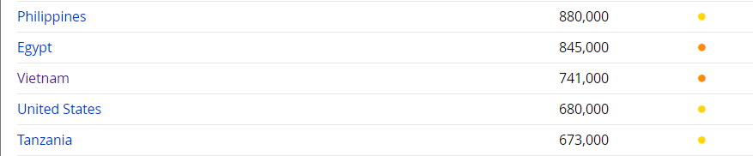
The problem of the study
Currently, statistics show that there are about 700,000 deaf people, including those born with deafness and those who become deaf due to accidents. This group often faces difficulties in communicating with others because they cannot hear or speak. Consequently, they tend to be isolated in society and face challenges in their daily lives.
Source: https://joshuaproject.net/people_groups/19007/VM

Slide 4
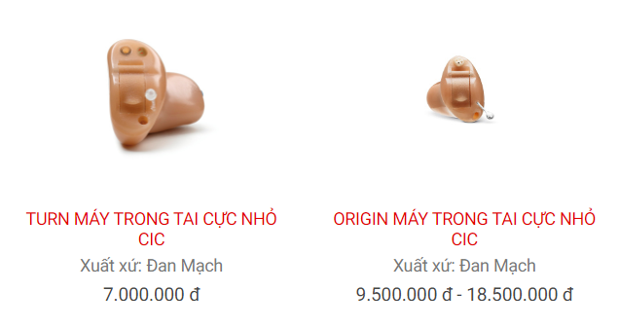
The problem of the study
This issue has attracted the attention of many scientists, and various solutions have been proposed, such as using hearing aids. However, the price of hearing aids in Vietnam is quite high, ranging from 1 to over 10 million VND. With such high prices, not everyone can afford them. Additionally, for severe cases of deafness, hearing aids may not be effective.

Slide 5
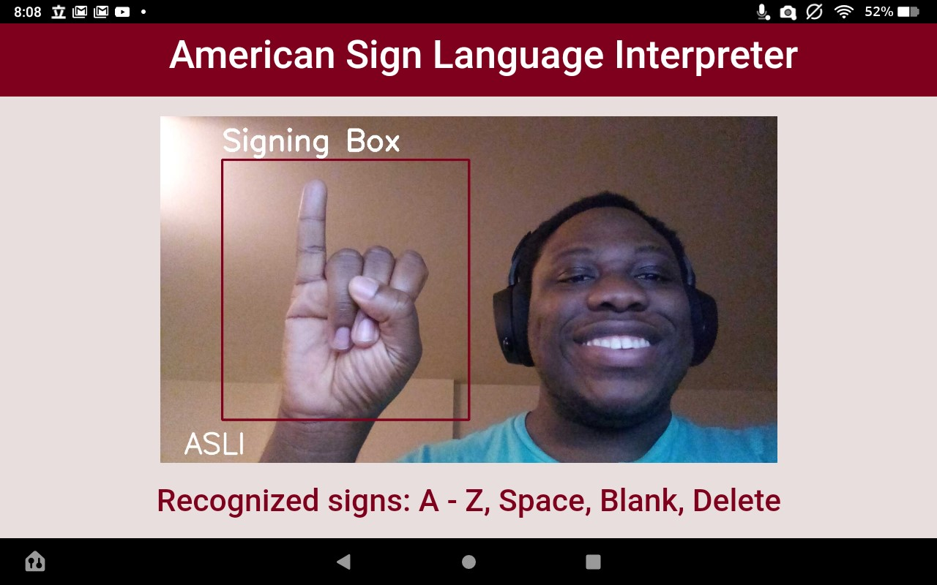
The problem of the study
Therefore, to support the deaf community, many studies have focused on using machine learning to recognize sign language (a language for deaf people to communicate).

Slide 6

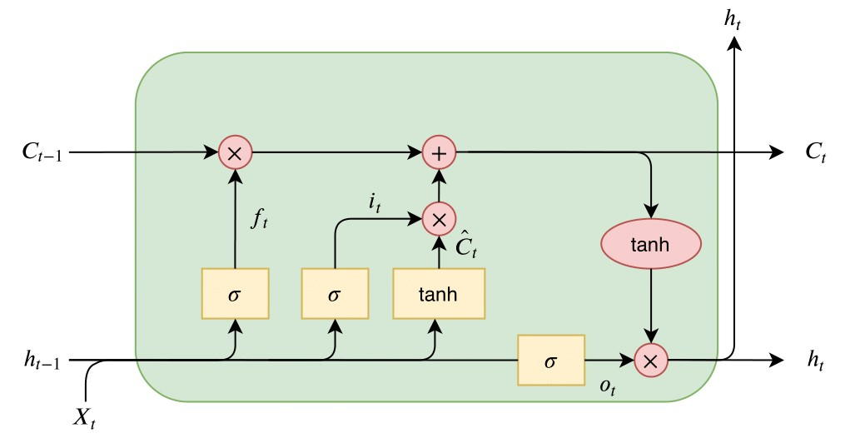
The methods of the study
The research method for recognizing Vietnamese sign language involves using machine learning to recognize images.
YOLOv8
LSTM

Slide 7

The methods of the study
Why choose YOLOv8 and LSTM?
- The reason for choosing YOLO is its reputation in real-time object detection with high accuracy.
- However, YOLO struggles with recognizing certain motions. In sign language, some words require combining two sequential actions to form a single word. Therefore, I chose LSTM to handle this, as it can process images in a time sequence.

Slide 8
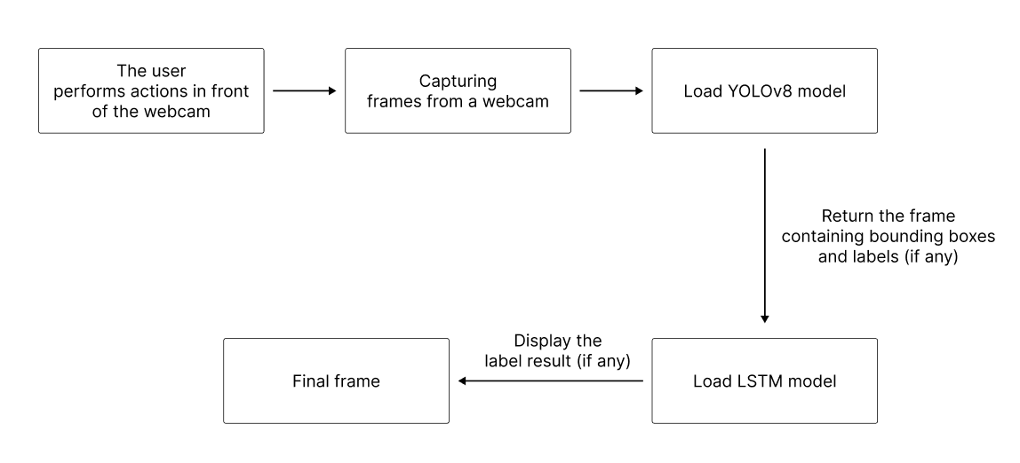
The methods of the study
The following is the operational structure of the system:

Slide 9
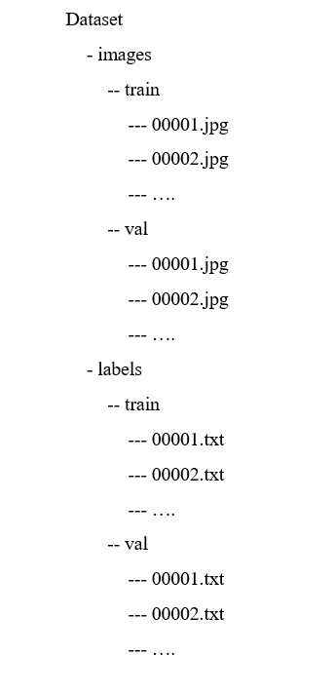
The methods of the study
DATASET
For YOLOv8, the data underwent a data preprocessing step. This involved collecting images, filtering them, resizing them to a suitable size (640 x 640), and annotating bounding boxes. As a result, the YOLOv8 dataset contains 8.487 samples (28 classes), with 80% for training and 20% for evaluation.

Slide 10
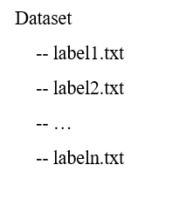
The methods of the study
DATASET
For LSTM, data was collected using MediaPipe Hands and saved the positions of Hand Land Marks in txt files. This process was done via webcam, recording the appearance of Hand Landmarks for each frame, ending after reaching 600 frames for that class. Consequently, the LSTM dataset has 11 classes, with 600 positions for each class.

Slide 11
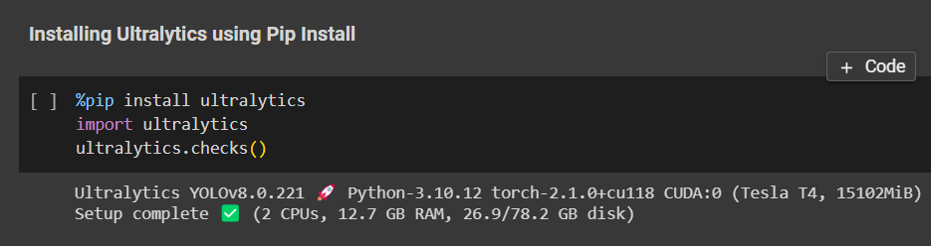
The methods of the study
Training
YOLOv8

Slide 12
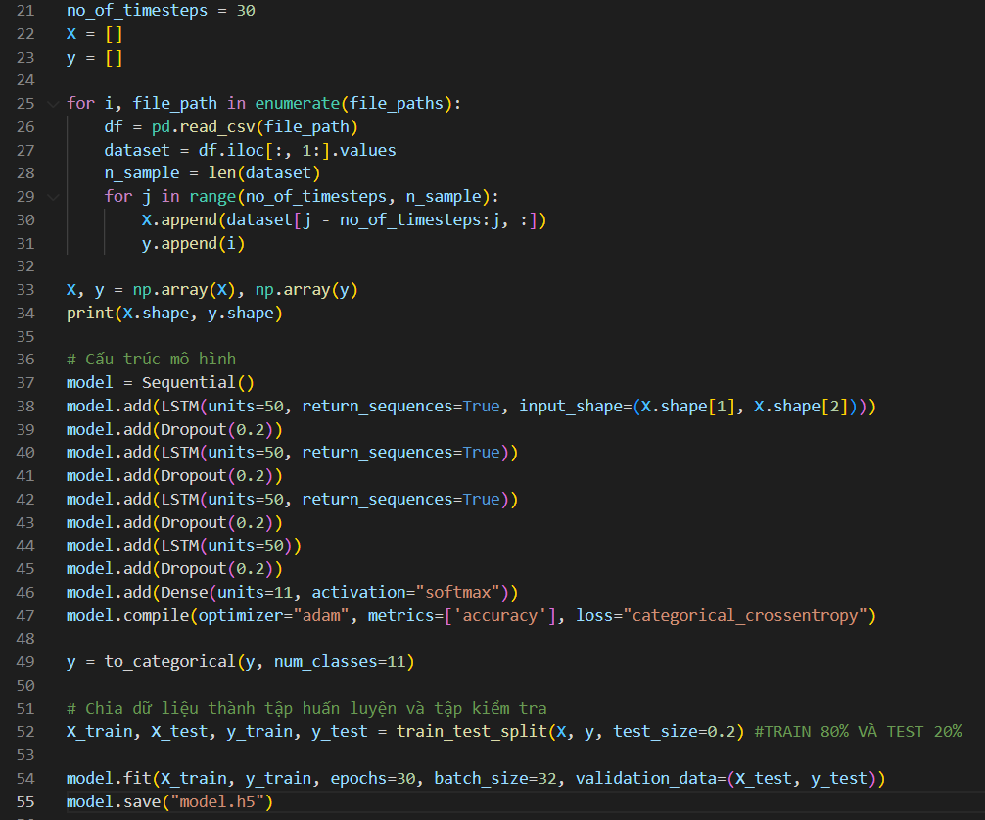
The methods of the study
Training
LSTM

Slide 13
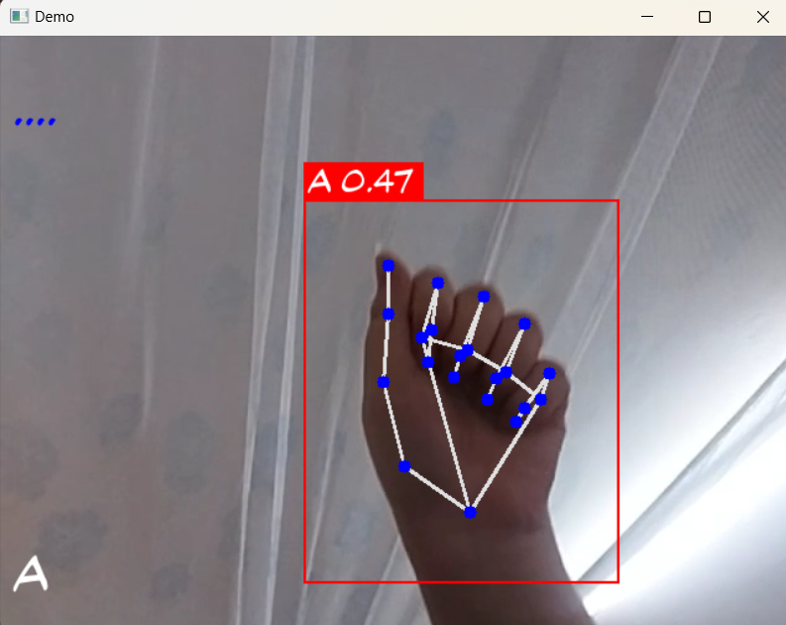
The results
For YOLOv8, the accuracy achieved was 87.2%, and for LSTM, it was 89.8%. The results are displayed below. The YOLOv8 test results appear as white text in the lower left corner of the screen, and the LSTM results are shown as light blue text in the upper left corner of the screen.

Slide 14
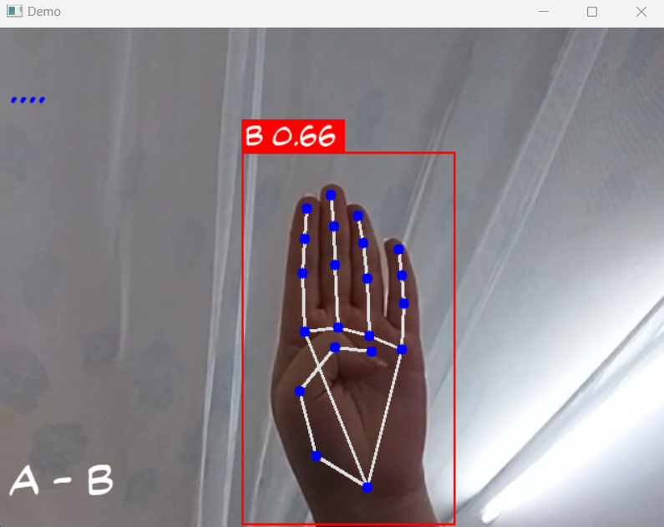
The results
YOLOv8
Test “A”
Test “B”

Slide 15
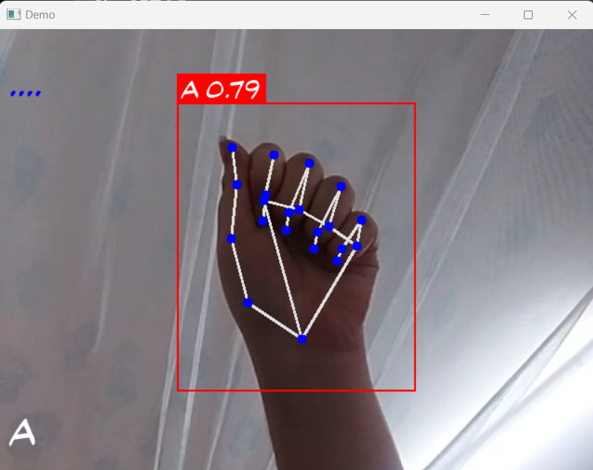
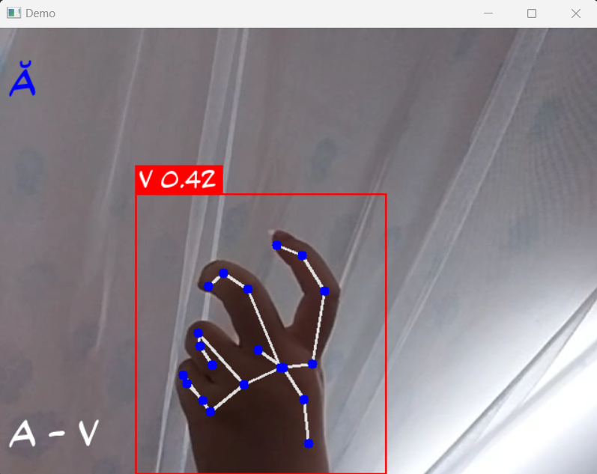
The results
LSTM
As the LSTM was being tested, YOLOv8 was still operational, hence the simultaneous display of results.
Test “Ă” with two sequential actions

Slide 16
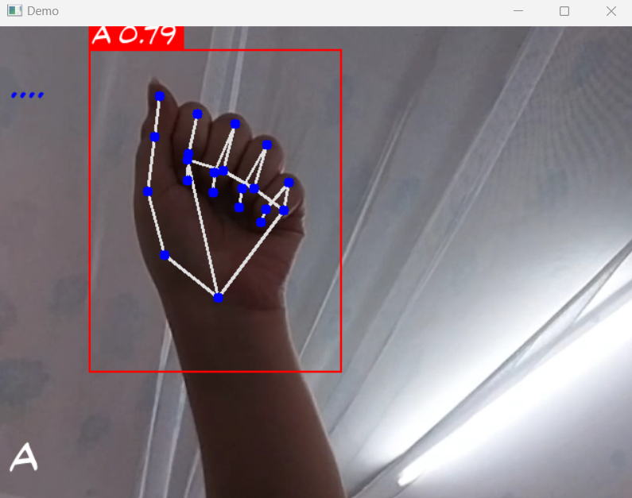
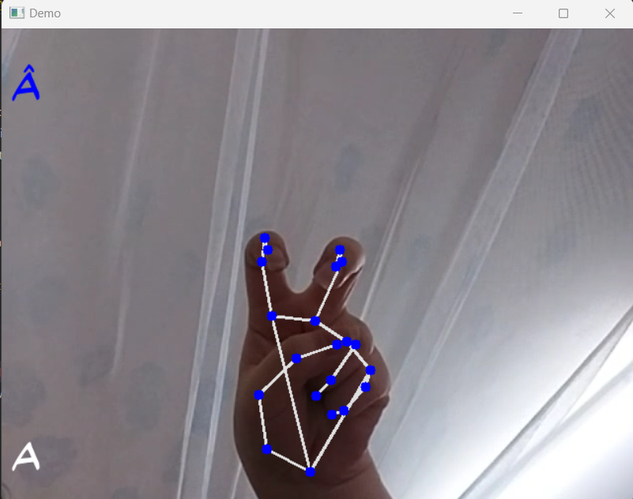
The results
LSTM
Test “Â” with two sequential actions

Slide 17
Demonstration

Slide 18
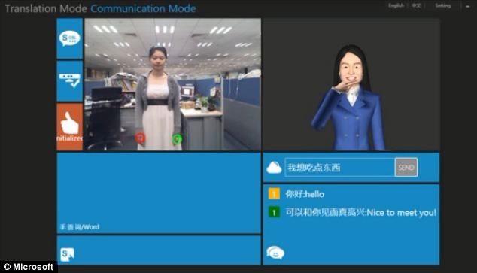
Future
- Convert sign language to speech
- Convert to speech to sign language, after that combined with a 3D model.

Slide 19

Thank you for attending!

